Slide 1
DESIGN AND ANALYSIS OF ALGORITHMS
MADE BY-ANAND PANDEY
CSE ii YEAR 181210009

Slide 2
1. DYNAMIC PROGRAMMING
Dynamic programming (usually referred to as DP ) is a very powerful technique to solve a particular class of problems. It demands very elegant formulation of the approach and simple thinking and the coding part is very easy. The idea is very simple, If you have solved a problem with the given input, then save the result for future reference, so as to avoid solving the same problem again.. shortly 'Remember your Past' :) . If the given problem can be broken up in to smaller sub-problems and these smaller subproblems are in turn divided in to still-smaller ones, and in this process, if you observe some over-lapping subproblems, then its a big hint for DP. Also, the optimal solutions to the subproblems contribute to the optimal solution of the given problem.

Slide 3
TWO WAYS OF SOLVING DP PROBLEMS
1.) Top-Down : Start solving the given problem by breaking it down. If you see that the problem has been solved already, then just return the saved answer. If it has not been solved, solve it and save the answer. This is usually easy to think of and very intuitive. This is referred to as Memoization.
2.) Bottom-Up : Analyze the problem and see the order in which the sub-problems are solved and start solving from the trivial subproblem, up towards the given problem. In this process, it is guaranteed that the subproblems are solved before solving the problem. This is referred to as Dynamic Programming.

Slide 4
EXAMPLE OF DYNAMIC PROGRAMMING
Count all possible paths from top left to bottom right of a m X n matrix
The problem is to count all the possible paths from top left to bottom right of a m X n matrix with the constraints that from each cell you can either move only to right or down

Slide 5
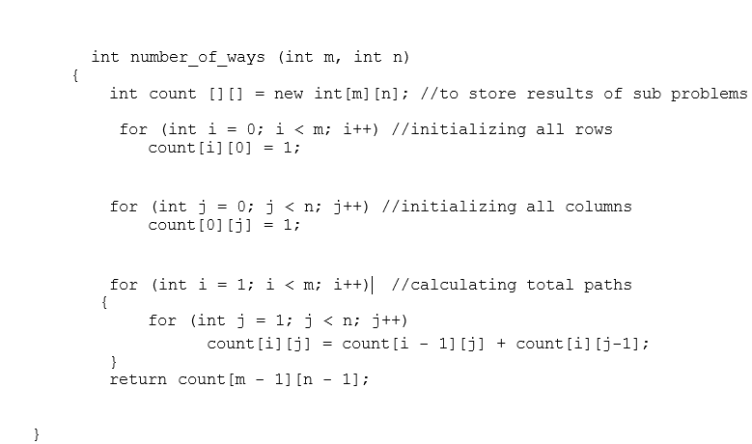
solution algorithm

Slide 6

For the explanation part , I am attaching my self made video

Slide 7
2. Greedy algorithm
A greedy algorithm is a simple, intuitive algorithm that is used in optimization problems. The algorithm makes the optimal choice at each step as it attempts to find the overall optimal way to solve the entire problem

Slide 8
EXAMPLE OF GREEDY METHOD
THE JUMP GAME
Given an array of non-negative integers, you are initially positioned at the first index of the array.
Each element in the array represents your maximum jump length at that position.
Determine if you are able to reach the last index.

Slide 9
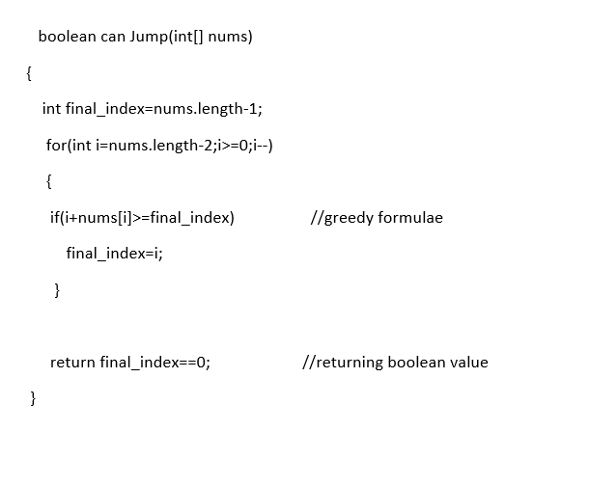
solution algorithm

Slide 10
For the explanation part , I am attaching my self made video

Slide 11
3. BACKTRACKING
Backtracking is a technique based on algorithm to solve problem. It uses recursive calling to find the solution by building a solution step by step increasing values with time. It removes the solutions that doesn't give rise to the solution of the problem based on the constraints given to solve the problem.
Backtracking algorithm is applied to some specific types of problems,
Decision problem used to find a feasible solution of the problem.
Optimization problem used to find the best solution that can be applied.
Enumeration problem used to find the set of all feasible solutions of the problem.

Slide 12
EXAMPLE OF BACKTRACKING
Given n pairs of parentheses, write a function to generate all combinations of well-formed parentheses.
For example, given n = 3, a solution set is:
[ "((()))", "(()())", "(())()", "()(())", "()()()" ]

Slide 13
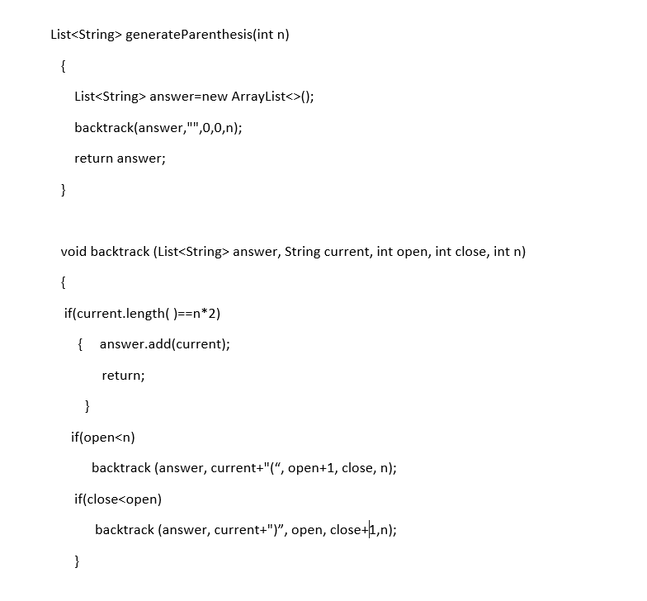
SOLUTION ALGORITHM

Slide 14
For the explanation part , I am attaching my self made video

Slide 15
4. Divide and conquer
In divide and conquer approach, a problem is divided into smaller problems, then the smaller problems are solved independently, and finally the solutions of smaller problems are combined into a solution for the large problem.
Generally, divide-and-conquer algorithms have three parts −
Divide the problem into a number of sub-problems that are smaller instances of the same problem.
Conquer the sub-problems by solving them recursively. If they are small enough, solve the sub-problems as base cases.
Combine the solutions to the sub-problems into the solution for the original problem.

Slide 16
EXAMPLE OF DIVIDE AND CONQUER
SORT THE GIVEN ARRAY USING QUICK SORT( DIVIDE AND CONQUER)

Slide 17
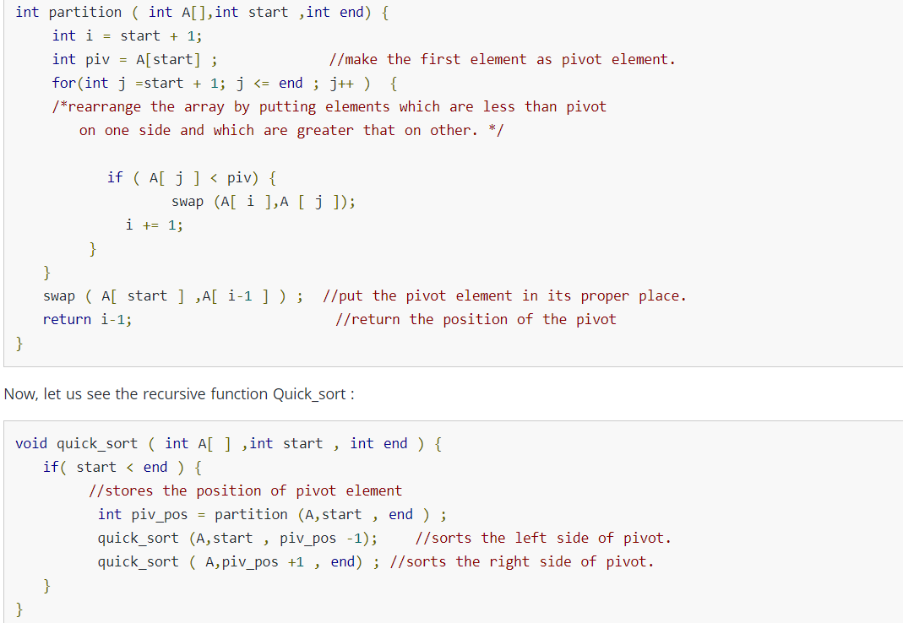
SOLUTION ALGORITHM

Slide 18
5. BOUND AND BRANCH
Branch and bound (BB, B&B, or BnB) is an algorithm design paradigm for discrete and combinatorial optimization problems, as well as mathematical optimization. A branch-and-bound algorithm consists of a systematic enumeration of candidate solutions by means of state space search: the set of candidate solutions is thought of as forming a rooted tree with the full set at the root.

Slide 19
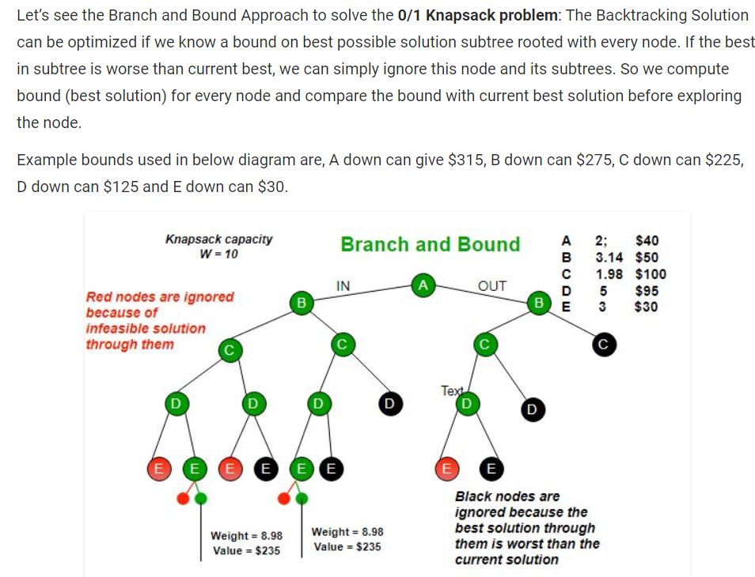
EXAMPLE OF BRANCH AND BOUND

Slide 20
THANK YOU
I HAVE SOLVED MORE PROBLEMS ON THE ABOVE ALGORITHMS ON MY TUBE CHANNEL “INTERVIEW AALA”

